Slide 1
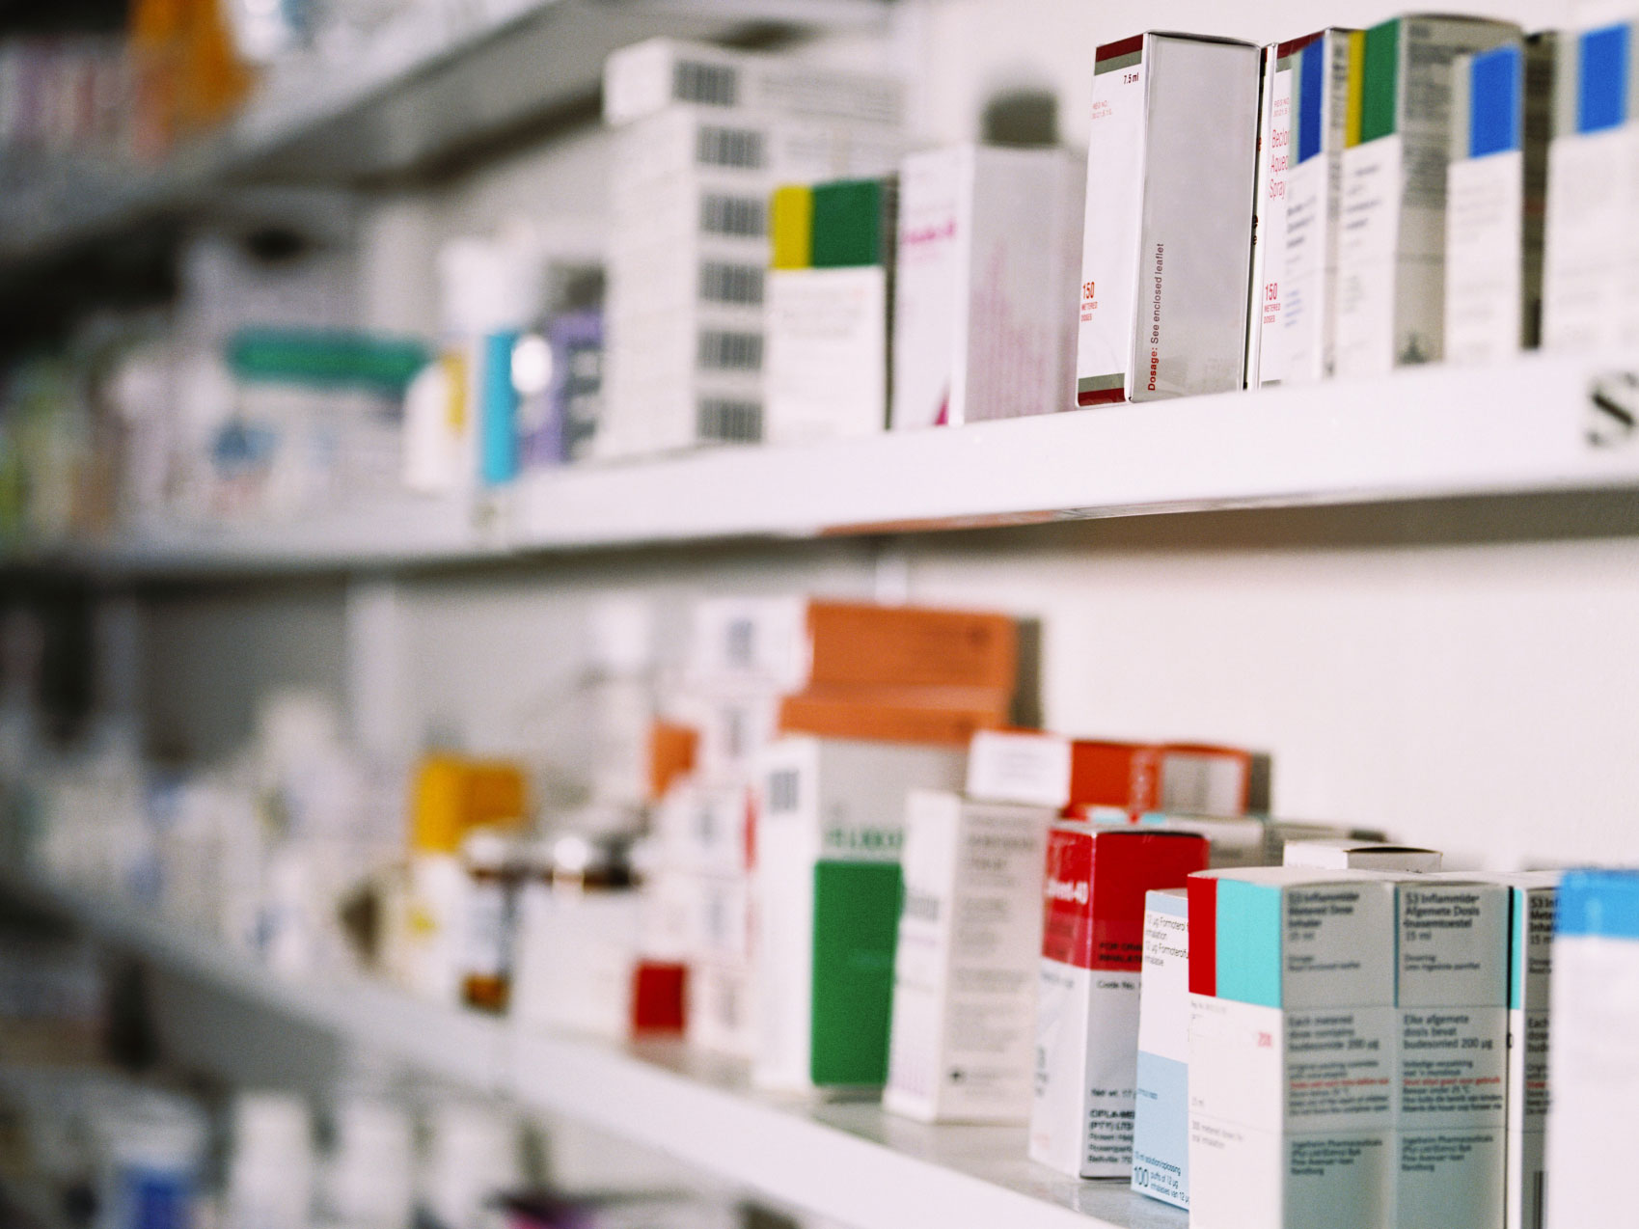
Cruz-Rabe Pharmacy
Request
System
Cruz-Rabe Maternity and General Hospital
MSYADD1 @ 2016 Bueno | Rosales

Slide 2

Project Authors
Project Professor
Mr. Manuel Sebastian Sanchez
Project Consultant
Dr. Manuel Calimlim Mr. Alfredo Calimbo
Project Adviser
Mr. Jayvee Cabardo
Project Team
Carl Dominique Bueno Glen Roy Rosales

Slide 3
Client Information
Company/Organization Name | Project Name | Primary Contact Person
Cruz-Rabe Maternity & General Hospital | Cruz-Rabe Pharmacy Request System | Carmelita D. Buenaflor
Health Facility Detailed Information
ACCREDITATION NO: H92007290 PMCC NO: 313634 INSTITUTION NAME: Cruz-Rabe Maternity and General Hospital ROAD NAME: 37 Gen. Luna Street BARANGAY: Tuktukan MUNICIPALITY: Taguig City PROVINCE: Metro Manila (SOUTH) REGION: NCR (SOUTH) CATEGORY: Level 2 CLASSIFICATION: Private

Slide 4
Project Context
In order to ensure patient's safety, cost effective processes and well managed admission on managing medical services, preventing clinical errors and use resources efficiently, business process should have a sufficient tool which is automation of “pharmacy request system.” Transactions that are processed in different factors including; IN and OUT patient order entry, dispensing orders, pharmacy inventory and purchasing management will stand-alone by providing innovative way of service. Our client Cruz-Rabe Maternity General Hospital combines with the latest technology enabling complete control to develop medical management and to bring satisfaction to their clients in terms of professional service.

Slide 5
Success Factors
We can asthat the system will be feasible if we meet the following requirements:
If the system seems to be helpful when hospital transactions (pharmacy requests) are now processed in just a few moments. .
Results produced are accurate and reliable for the patients..
Pharmacy records can be track down easily from its database.
Less resources are produced but service will be doubled.
We can assume that the system will be successful for a long term if we meet the following requirements:
If the system are useful to patients and hospital staffs in exchange to service, performance and satisfaction.
If it will generate enough revenue to the maintenance of the system.

Slide 6
Business Risk
RI-1: Might take critics since the pharmacy department will be adapting
changes towards its business transactions.
RI-2: It will require equipment and services in order to produce the system.
This means, the organization need to invest in this project as there is a
possibility to make changes in certain aspects such as its maintenance
and security.

Slide 7
Description
A pharmacy within a hospital case, wherein there will be only IN and OUT patients for pharmacy request entry.
The system will have the following:
Order Prescription,
Patient History Records,
Stock Inventory for Medicine and Supplies Directory,
Department Directory,
Doctor Directory.

Slide 8
Purpose and Success Factors
P1: Make the processing of prescriptions faster and reliable.
P2: Lessen the loss of data of the existing and upcoming pharmacy records.
P3: Increase efficiency of work in input of information and processing of
requests by the pharmacists upon implementation.
S1: The pharmacists are able to maximize productivity with the use of the Pharmacy Request System (PRS).
S2: Receive a positive feedback from the client regarding the increase average amount of work done by the Pharmacy Department.

Slide 9
General Objectives
Paperless Transactions System (PTS)
Automation of Pharmacy Request System
Convenient way of discharging patients.
.

Slide 10
Specific Objectives
Eliminate mistakes caused by manual steps and workarounds.
Pharmacy transactions will be generated electronically for accessibility.
Pharmacy system will be more reliable and convenient.
Less tedious on data mining and documentation.
Save and Track Relevant Information in real time.

Slide 11
Vision Statement
A Web-Based System and Database for processing pharmacy request within a system, dedicated to ease the way of accepting requests by pharmacists to process the automated prescription orders and dispensing of orders in a better way. It will not only verify the information received, but also keep the records in a secured database which can be accessed for future preferences. Unlike the old-way of manual processes, Cruz-Rabe Pharmacy Request System intended to improve the quality of work in the medical field by providing the essential steps of transactions in fast-pace. The vision of this system is determined to meet patients satisfaction in terms of service.

Slide 12
Scope and Limitations
Pharmacy Request System is intended for pharmacists to use in their service that assists patients’ drug requests that is prescribed by a doctor. Alternatively, the Pharmacy Requests will be assumed to be automated and data will be on a database for data warehouse. This scheme will ease the work of the auditing staff and the discharging process of patients.
.
Assumptions and Dependencies
AS-1: Additional equipment, services, and maintenance, will be
improvised for the authorized personnel to do the business processes. AS-2: The hospital will be developed to ensure the system was implemented
well. Lesser hardcopies, more softcopies for the records.
DE-1: If the pharmacy records will be accessible with the other departments to
support the system for consistency.

Slide 13


Review of Related Literature

Slide 14
Technical Background
◌ Major Features:
F1: Convenient way of purchasing Medicine and Supplies
within the pharmacy.
F2: Can easily do inventory check for tracking down changes on stocks.
F3: Discharging patients with electronic records.
F4: Checks the validation and availability of the requests.
F5: Secures the authorization of the pharmacists and authorized personnel to do the process.
F6: Sends the information throughout the other departments electronically.

Slide 15
UML DIAGRAMS
And Tables

Slide 16
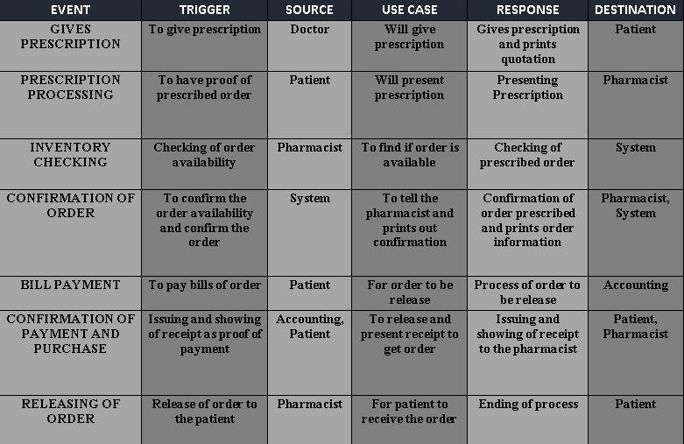
Event table

Slide 17
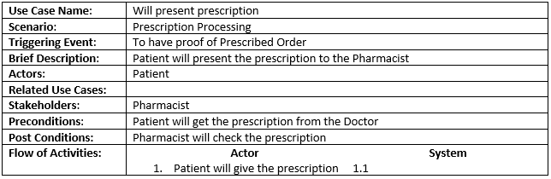
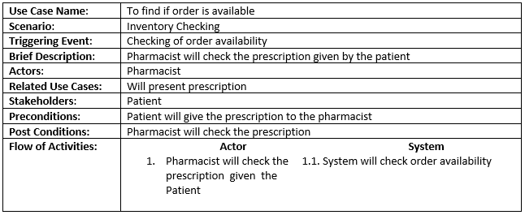
Use Case Full Definition

Slide 18
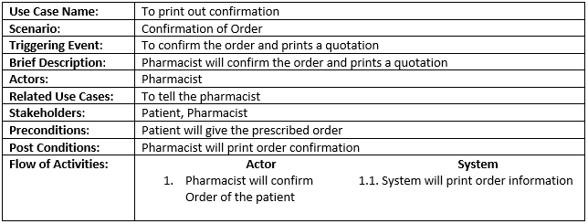
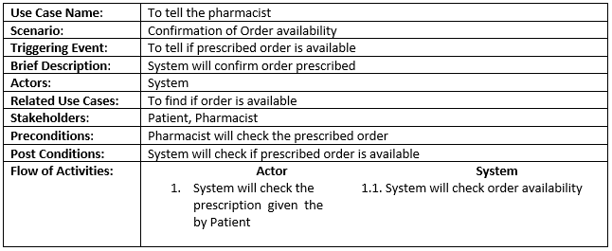

Slide 19
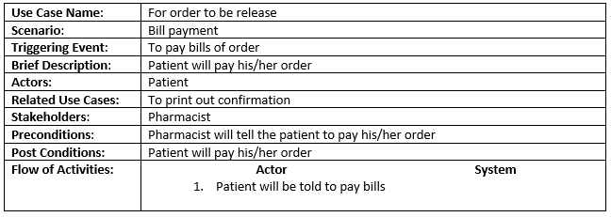
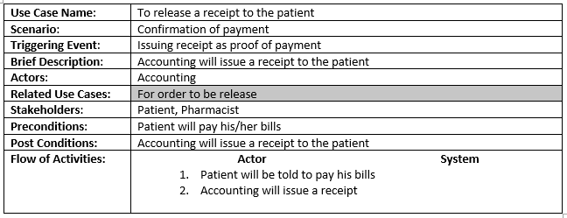

Slide 20
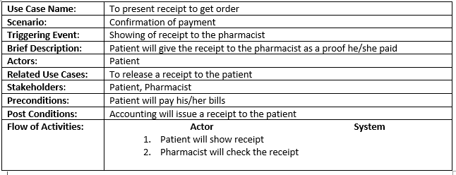
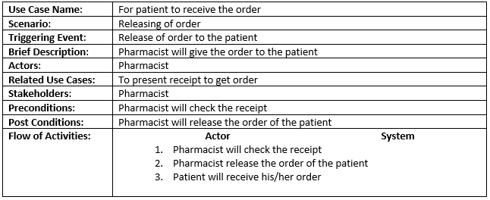

Slide 21
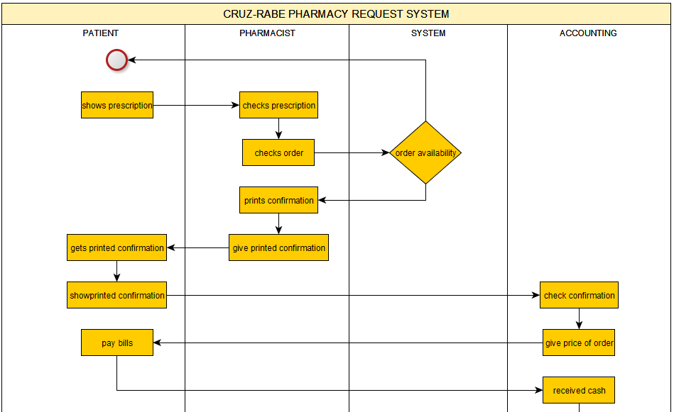
Activity Diagram

Slide 22
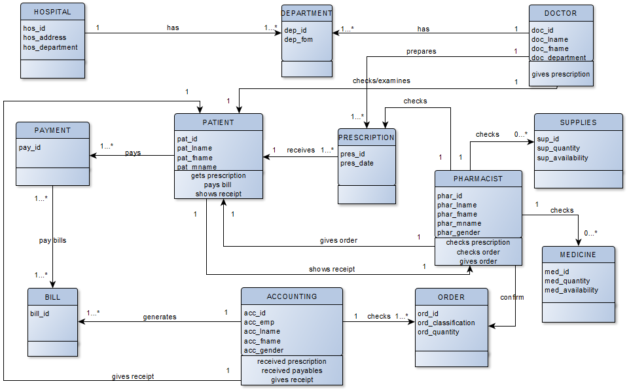
Class Diagram

Slide 23
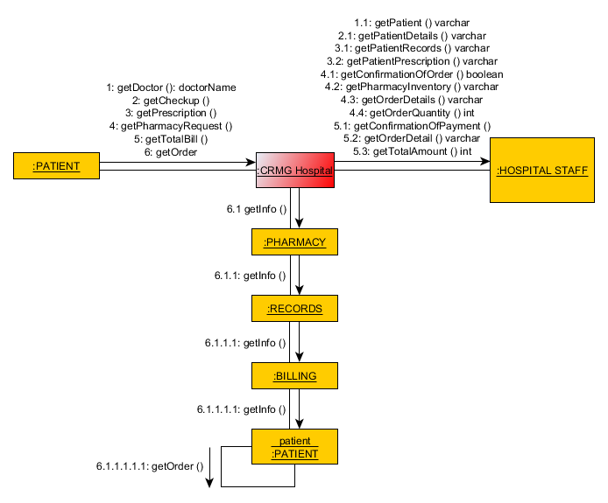
Communication Diagram

Slide 24
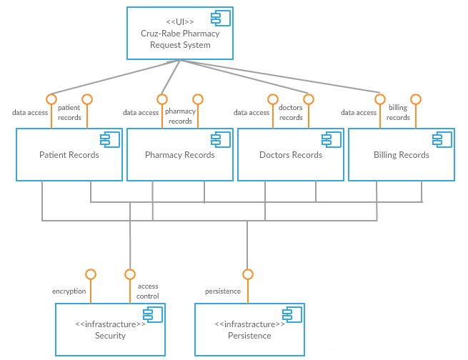
Component Diagram

Slide 25
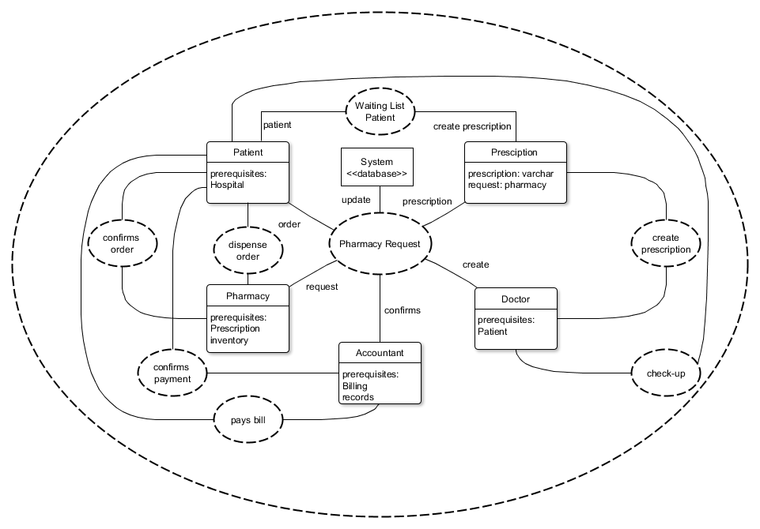
Composite Diagram

Slide 26
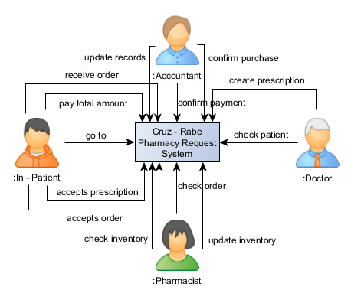
Context Flow Diagram
In - Patient

Slide 27
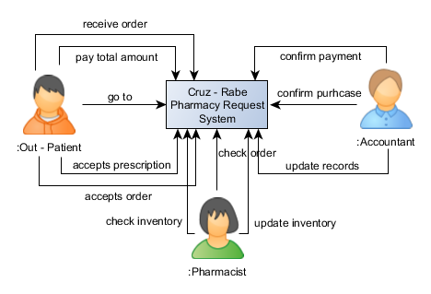
Context Flow Diagram
Out - Patient

Slide 28
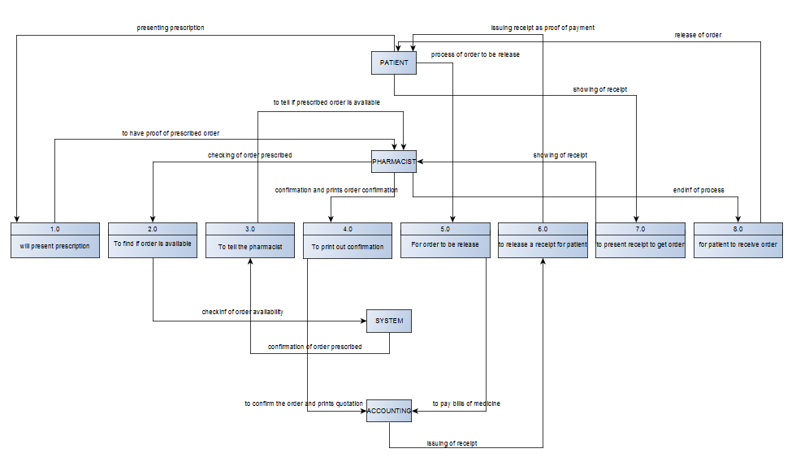
Data Flow Diagram

Slide 29
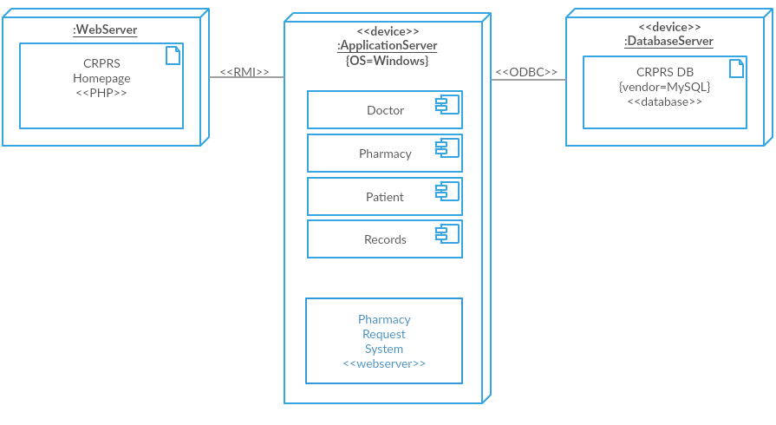
Deployment Diagram

Slide 30
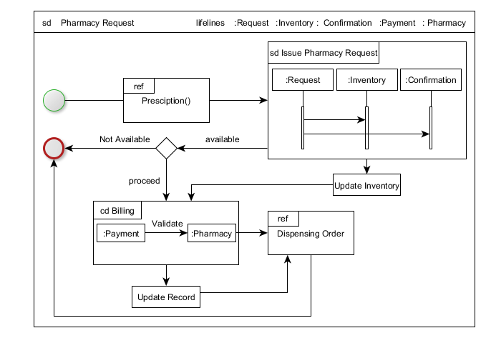
Interaction Overview Diagram

Slide 31
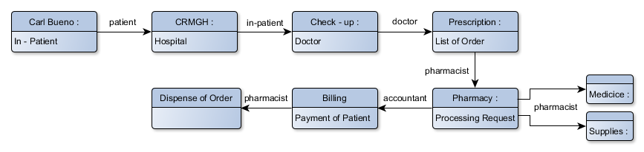
Object Diagram
In - Patient

Slide 32
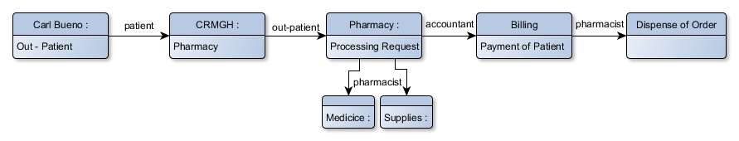
Object Diagram
Out - Patient

Slide 33
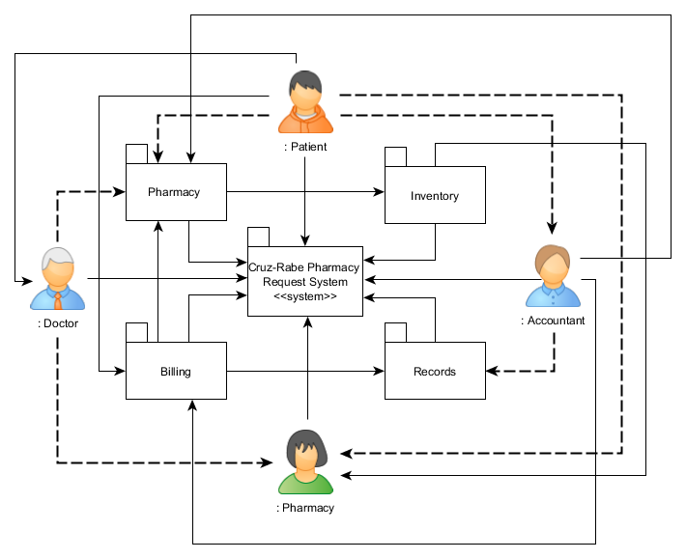
Package Diagram

Slide 34
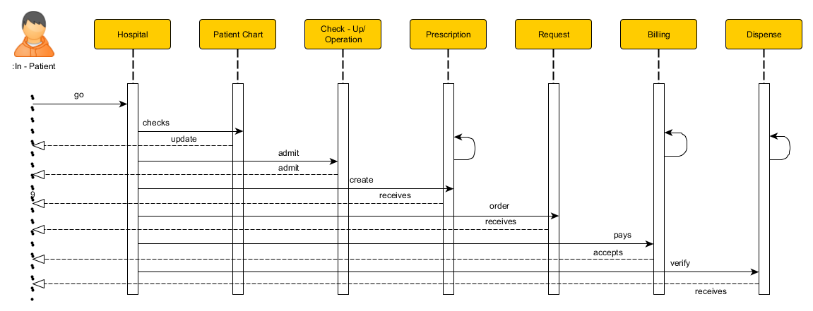
Sequence Diagram
In - Patient

Slide 35
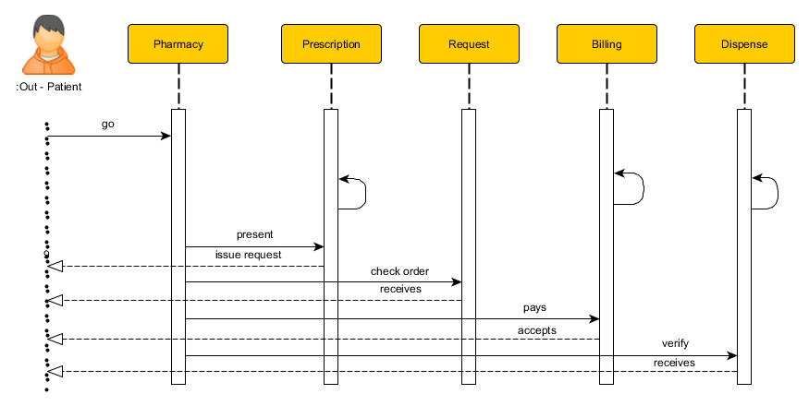
Sequence Diagram
Out - Patient

Slide 36
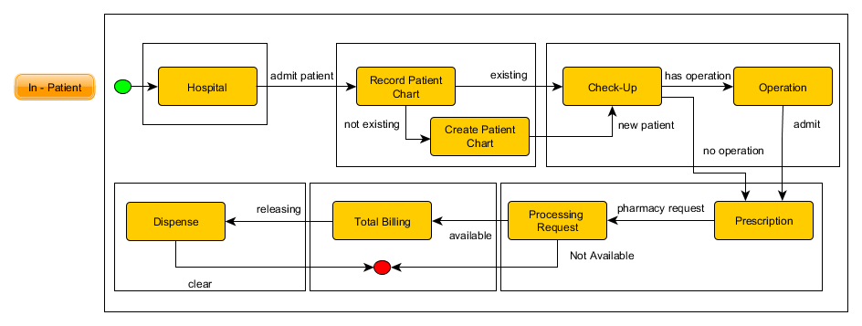
State Machine Diagram
In - Patient

Slide 37
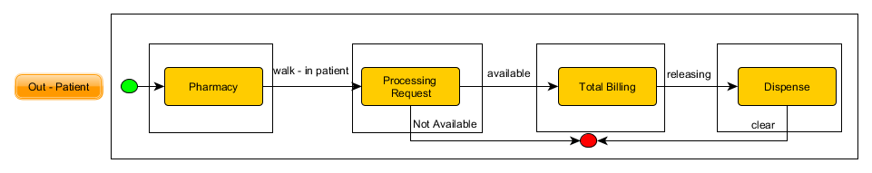
State Machine Diagram
Out - Patient

Slide 38
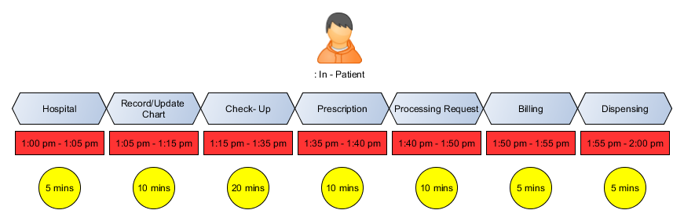
Timing Diagram
In- Patient

Slide 39
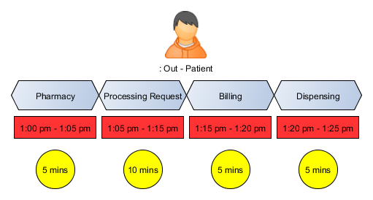
Timing Diagram
Out - Patient

Slide 40
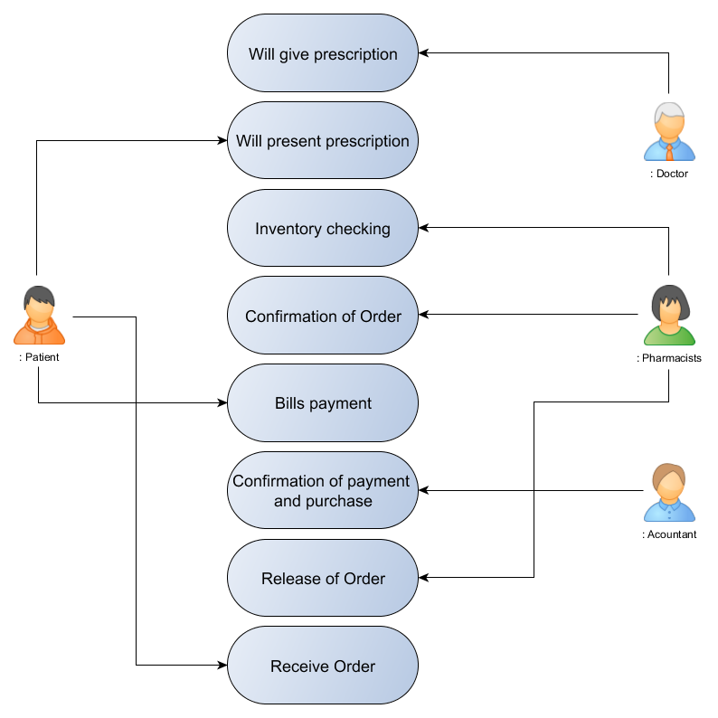
Use Case Diagram

Slide 41
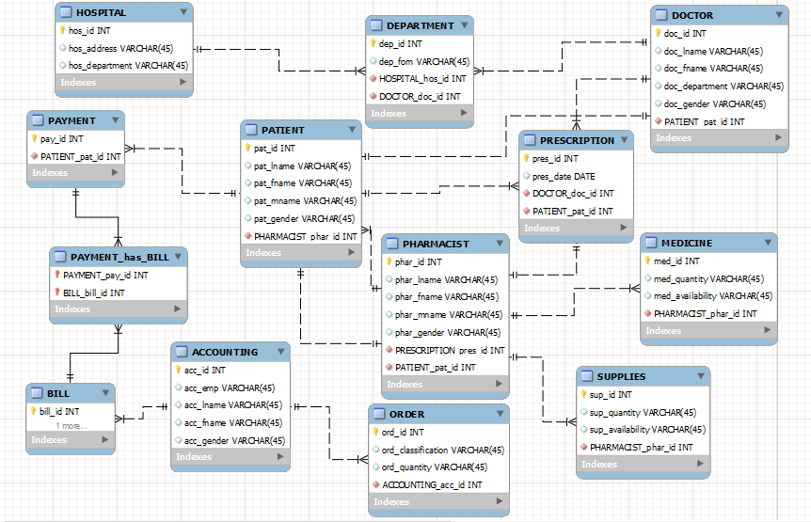
Entity-Relationship Diagram

Slide 42
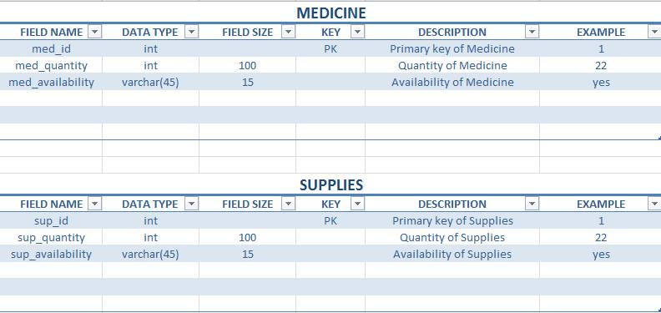
Data Dictionary

Slide 43
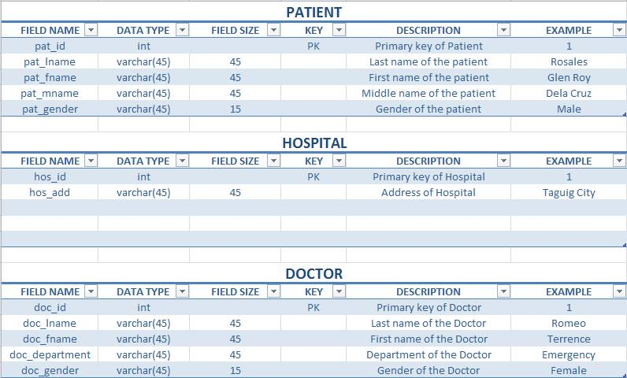
Data Dictionary

Slide 44
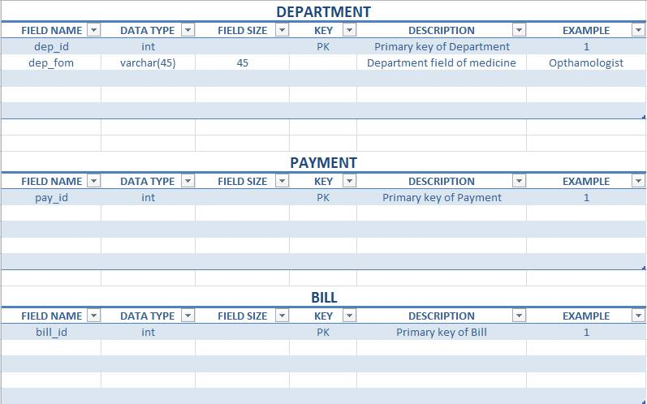
Data Dictionary

Slide 45
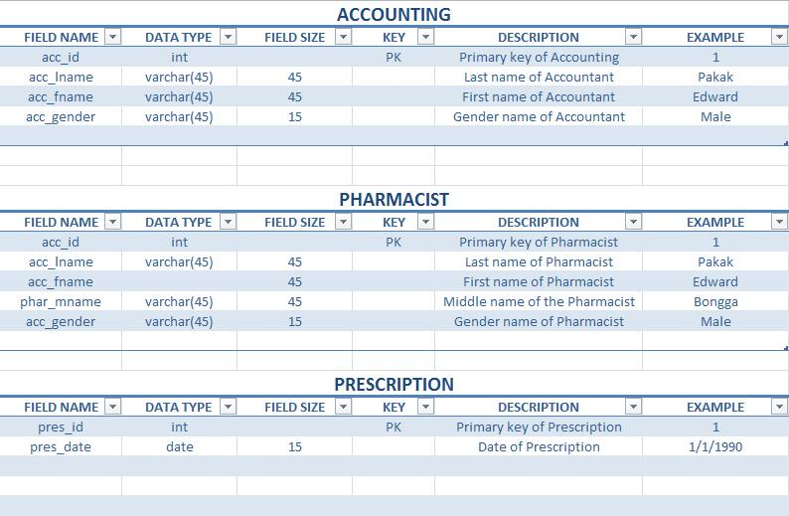
Data Dictionary

Slide 46
Reference/s:
http://projects2.apc.edu.ph/wiki/index.php/Project_-_Cruz-Rabe_Pharmacy_Request_System_%28CR-PRS%29_-106
http://moodle2.apc.edu.ph
http://www.omnicell.com/About_Omnicell.aspx
https://www.pioneerrx.com/web/pioneerrx

